Slide 1


Track and TRACE
Merryl Riley
Committed to providing safe, cost effective, quality medicinal products.

Slide 2


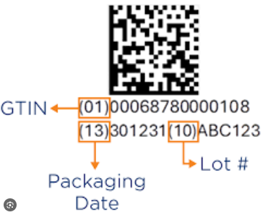

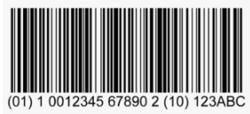

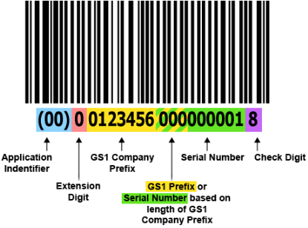
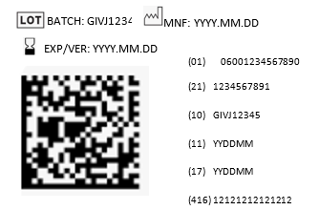
NBI’s APPROACH
#1 Understand GS1 terminology first
2D datamatrix barcode
GS1-128 barcode
Application identifier
Human Readable Interpretation (HRI)
Non -Human Readable Interpretation (HRI)
GTIN-14 (Global trade item number)
Serial shipper container code
Notes:
Trading partners might require different information
Human biologicals, health products, medical devices……all may have different requirements
The Serialisation system needs to cater for these differences
Application Identifier: Unique number which precedes alphanumeric text eg (01) is always GTIN number.
Human Readable Interpretation: all the information which is printed and can be read by a human but which is encoded
non Human Readable Interpretation: other information, symbols etc which is not encoded
GTIN 14 number - Unique number used to identify a trade item
Serial Shipper Container code (SSCC) - Unique number used to identify a logistics unit (case, shipper, pallet) – 18 digits
GS1-128 barcode = a barcode system used for labeling and tracking goods in logistics and supply chains
2D datamatrix = HRI all encoded here

Slide 3



NBI’s APPROACH
#2 Determine the different levels of packaging (packing hierarchy)
Primary pack (product in direct contact with the container)
Secondary pack (primary pack in contact with carton)
Tertiary pack (carton in contact with shipper)
Notes:
NBI only has three levels in the hierarchy

Slide 4
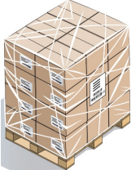
NBI’s APPROACH
#3 Identify which items are TRADE ITEMS and/or LOGISTICS UNITS
TRADE ITEM: Any item upon which may be priced, ordered or invoiced at any point in the supply chain
LOGISTICS UNIT: Any item established for transport/storage which will be managed through the supply chain
A LOGISTICS ITEM may also be a TRADE ITEM
Single unit
NBI’s trade item
Shipper/case
NBI’s Logistics unit
Pallet
Notes:
NBI only has one trade item for now.
Customer order individual units –may at some stage a shipper

Slide 5
NBI’s APPROACH
#4 Assign GTIN 14 (Global Trade Item numbers) to every Trade item and Logistics unit which is also a Trade item
Many rules: Different language, packaging changes, brand changes, number of items in a pack, formulation changes
Purchase the unique Company Prefix from GS1 (eg 600988101)
Purchase range of GTIN numbers
Secondary pack
Tertiary pack/Shipper
Pallet
Useful document: http://www.gs1.org/1/gtinrules/

Slide 6
NBI’s APPROACH
#5 Determine what information needs to be printed on each item (HRI and nHRI)
Need to take into consideration:
GS1 Guidelines
Regulatory authority
Government authority
Trading partners
Most common HRI information required:
(01) GTIN number
(21) Serial number
(17) Expiry date
(10) Batch number
(416) Global location number
(11) Manufacturing date
(00) Serial shipper container code
Other nHRI information:
Price
License number
Symbols
Dates (GS1 format can be confusing - yymmdd)
Notes:
Trading partners might require different information
Human biologicals, health products, medical devices……all may have different requirements
The Serialisation system needs to cater for these differences
nHRI may be necessary: end use may not be familiar with the expr date format

Slide 7
NBI’s APPROACH
#6 Packaging considerations
How much space in required
Position on the pack
Format (could be different formats)
Ink durability (Storage conditions)
Unvarnished surface
Integration with the packing line (Print on flat carton or packed unit)
Notes:
Space: Different products packs have different space available
Position: Top panel – assists with aggregation if there is automatic overhead camera verification
Format: space may dictate this
Unvarnished: reflections throw the OCV off. Ink less likely to smudge
Ink durability: for cold storage conditions
Integration: automated lines, manual packing
Packed unit: disadvantage is if OCV fails, have to repack all the contents of the package as well.
Flat carton: OCV in advance of packing

Slide 8
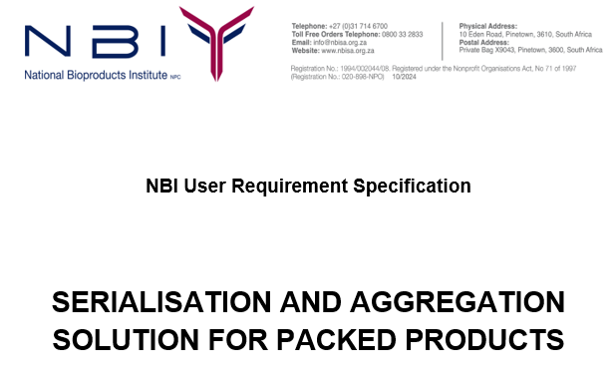
NBI’s APPROACH
#7 Developing the system
User Requirements Specification
Standards to be adhered to:
cGMP – record keeping, process flow, design, access control, audit trail
GS1
21 CFR part 11 compliance – reliable and accurate electronic records
Health Authority guidelines
Department of Health guidelines
Requirements of the system:
Integration with SAP
What information is required to be printed
Ability to print on a variety of pack sizes
Data storage
Testing requirements
Validation
Functional Specification
Design specification
Testing
How will the system work?
Authorisation levels
HMI screens (testing and production)
Recipe driven
Line speed
Flexibility for different product requirements
Handling of rejects
Handling samples
Aggregation
How will the system look?
System architecture
Components – printer, camera
Layout of the skid
HMI screens
Batch data records
OCV – accuracy and sensitivity
Data: accuracy and recovery
Different package configurations (blanks)
Notes:
URS: Wish list of what NBI would like to have – includes standards, specifics of the requirements
FS: address how the system will work
DS: address how the system looks: how NBI SAP will interface with Pyrotecs software for product tracking and data collection
CFR Part 11 compliance means adhering to the U.S. Food and Drug Administration (FDA) regulations regarding electronic records and signatures. This ensures that electronic data is reliable, trustworthy, and equivalent to paper-based documents and handwritten signatures. It requires implementing specific controls like audit trails, system validations

Slide 10
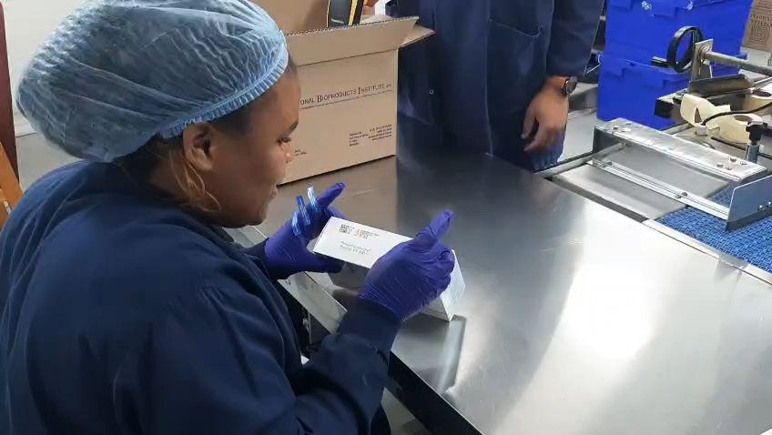
Aggregation step

Slide 11
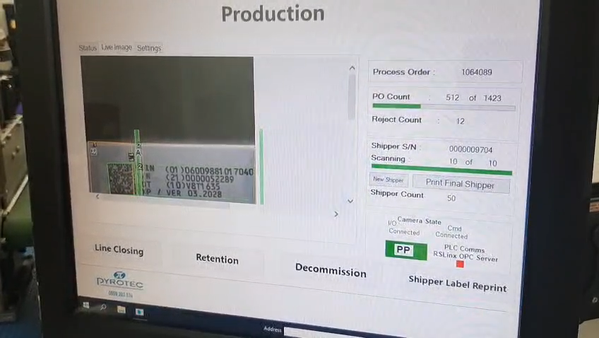

Slide 13
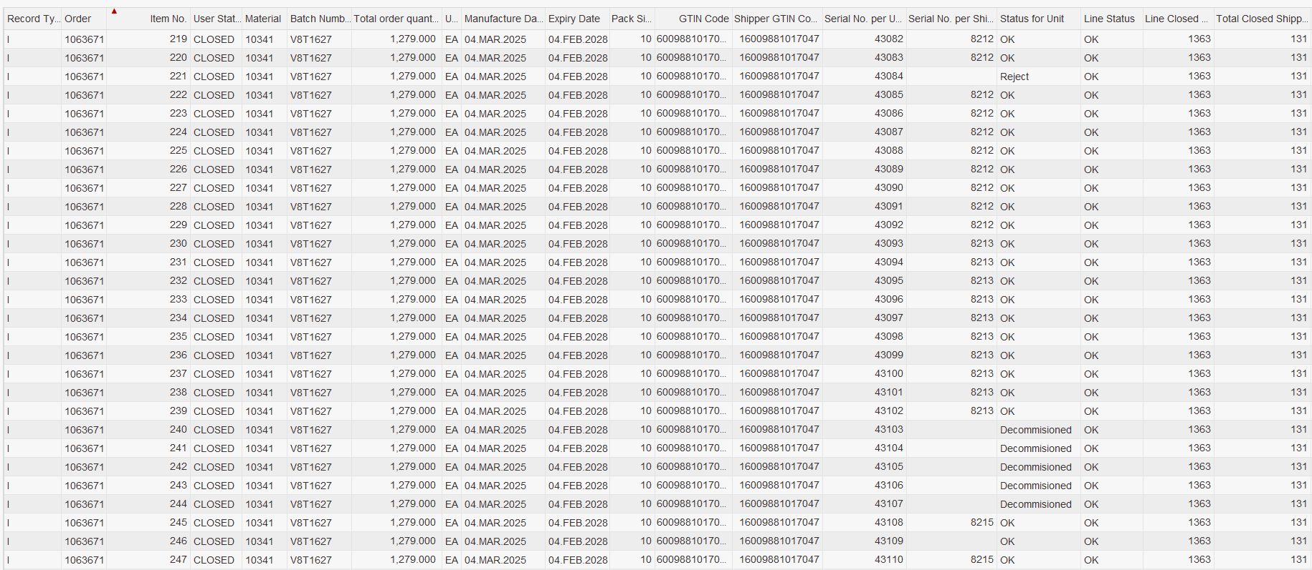
BATCH RECORD
Notes:
Green – batch data pulled from SAP
Orange - Rejected item – binned and repacked to get a new number
Red – Decommissioned – damaged pack, repacked to get a new number (if primary material is not damaged)
Another status = retained (sample)

